Slide 1


Revolutionizing Interaction: Hand Gesture Recognition
Project Supervisor :
Prof. (Dr.) Surender Dhiman
(Head of Department - ECE)
By:
Zehra(06115602821)
Tamanna(08015602821)
Shivansh(05815602821)

Slide 2
01
Introduction
Table of Contents
02
Objectives
03
Literature Survey
04
Methodology Adopted
05
Software Used
06
Applications and Advantages
07
Challenges in Development
08
Future Directions
09
Conclusion
10
References

Slide 3
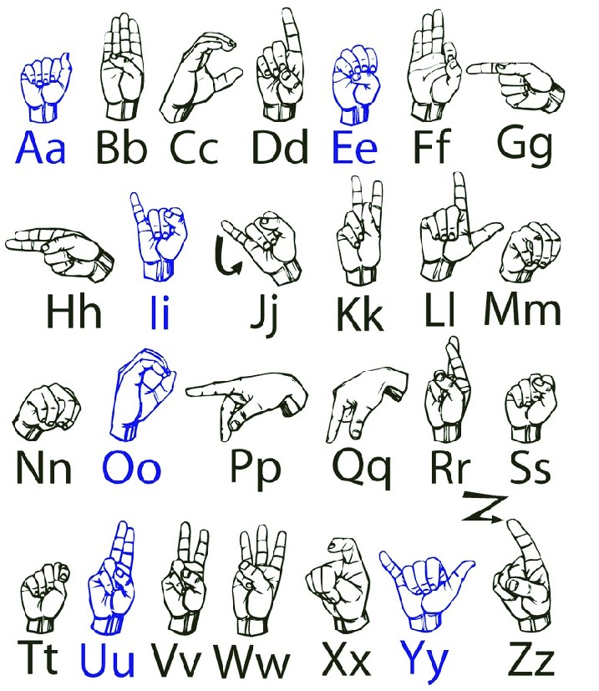
1
Introduction
Hand gesture recognition serves as a vital bridge in Human-Computer Interaction, enhancing usability and interaction frequency. By allowing intuitive control, it offers a natural interface promoting seamless communication between users and devices. With technology advancing rapidly, gesture recognition is evolving into a key element in creating smarter technology solutions. It's not just about control; it's about creating experiences that resonate with human behavior and emotions.
Photo by Pexels

Slide 4
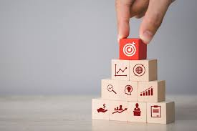
2
Objectives
Our goal is to develop a robust gesture recognition system that identifies and classifies hand movements in real-time. Crucially, this system also seeks to support assistive technology for individuals with disabilities, promoting inclusivity. The project focuses on creating technology that understands and reacts appropriately to human gestures, improving interactions.
Photo by Pexels

Slide 5
3
Literature Survey
Accurate Gesture Detection: Implement a model capable of recognizing and classifying a predefined set of hand gestures with high accuracy and reliability. This involves training the model on diverse gesture datasets and optimizing it for real-world scenarios.
Real-Time Performance: Ensure that the gesture recognition system operates in real-time, providing immediate feedback and responses to user inputs. This requires efficient processing of video frames and quick inference times.
User-Friendly Interface: Develop an intuitive interface that allows users to interact with the system seamlessly. The interface should clearly display recognized gestures and provide actionable outputs or feedback based on the gestures detected.
Robustness and Adaptability: Design the system to handle variations in lighting conditions, hand sizes, and gestures performed at different speeds. The model should be adaptable to different environments and user characteristics.
Photo by Pexels

Slide 6
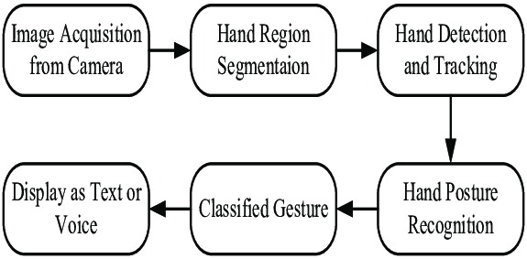
4
Methodology Adopted
Photo by Pexels

Slide 7
5
Software Used
Programming Language –
1)Python: Chosen for its extensive support for libraries and frameworks,
ease of use, and strong community support.
Libraries and Frameworks –
1)OpenCV: For real-time image and video processing, including
frame extraction, hand region detection, and feature extraction.
2)TensorFlow / Keras / PyTorch: For building and training machine
learning models, including CNNs for gesture recognition.
3)scikit-learn: For additional machine learning algorithms and tools for
model evaluation.
Photo by Pexels

Slide 8
6
Applications
1. Sign Language Translation
Deaf and Mute Communication: Hand gesture recognition is extensively used to translate sign language into text or speech, helping improve communication between deaf individuals and those who do not know sign language.
2. Smart Home Automation
Control Home Devices: Smart homes use gesture recognition to allow homeowners to control lights, fans, or other appliances with simple hand movements.
3. Automotive Applications
Gesture-based Controls in Cars: Drivers can control the infotainment system, air conditioning, or even answer calls using simple hand gestures, reducing the need for manual control and minimizing distractions.
Photo by Pexels

Slide 9
Advantages
1. Intuitive Interaction
Ease of Use: Gestures are a natural form of communication, making hand sign recognition systems easy to use, especially for people who may not be familiar with advanced technology.
2. Accessibility for Disabled Individuals
Sign Language Translation: This technology can translate sign language into text or speech, greatly enhancing communication for deaf and mute individuals.
3. Enhanced Safety in Automotive Applications
Minimized Driver Distraction: In vehicles, drivers can control the infotainment system or other features through gestures, reducing the need to take their hands off the steering wheel and thereby improving safety.
Photo by Pexels

Slide 10

7
Challenges in Development
Despite the exciting potential, challenges exist in accurately recognizing gestures in varying conditions and contexts. Environmental factors, lighting changes, and user diversity present hurdles to overcome in development. We are committed to addressing these challenges through rigorous testing and model refinement processes. Preparing for these challenges is essential for creating a reliable and effective gesture recognition system.
Photo by Pexels

Slide 11
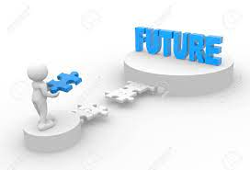
8
Future Directions
As technology evolves, so will our gesture recognition system, incorporating advanced algorithms and techniques. Future improvements may include better recognition rates and adaptability to a wider range of gestures. Exploring integration with virtual reality and augmented reality offers exciting new possibilities for user interaction. Our vision includes creating a system that not only recognizes gestures but understands their context and intent.
Photo by Pexels

Slide 12

9
Conclusion
In conclusion, our project on hand gesture recognition is not just about technology; it's about enhancing human experiences. Through innovative approaches and rigorous research, we aim to make interactions effortless and intuitive. The potential applications extend beyond entertainment, pushing boundaries in accessibility and user engagement. This journey is just beginning, and we are excited for the future of Human-Computer Interaction.
Photo by Pexels

Slide 13
References
10
RESEARCH PAPERS:
1)Real-Time Hand Gesture Recognition for American Sign Language Using OpenCV :
The research focuses on real-time ISL recognition using machine learning
algorithms like SVM and KNN, with OpenCV handling the image processing tasks.
2)Hand Gesture Recognition for American Sign Language: A Survey of Techniques
and Tools - This survey paper provides a detailed overview of the techniques and
tools used for ISL recognition, emphasizing the role of OpenCV in preprocessing
and feature extraction.

Slide 14
THANK YOU

